Slide 1
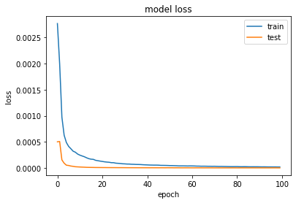
Classifier – LSTM
Neurons – 100
Dropout – 2%
Epoch – 100
Dataset – csh101.ann.features
Loss | 2.0576e-05
Accuracy | 1.0000
Val_Loss | 3.0618e-06
Val_Accuracy | 1.0000

Slide 2
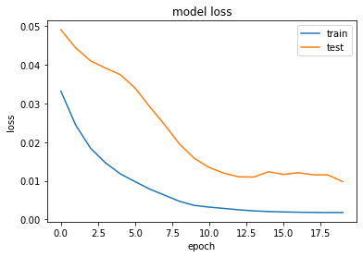
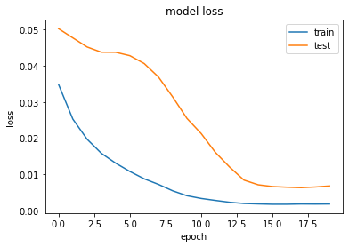
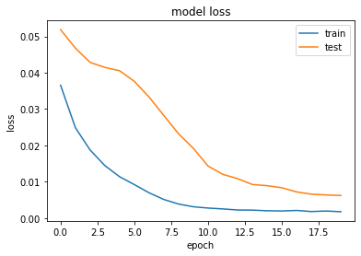
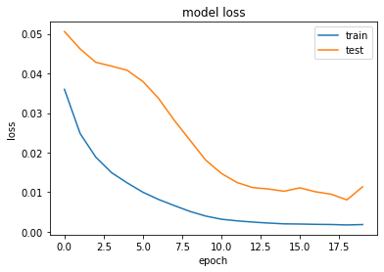
Tree Based
L1 Based
Low Variance
Random Forest
LSTM Applied on Feature Engineered Dataset
-Lower Accuracy
- Time-series pattern is lost

Slide 3
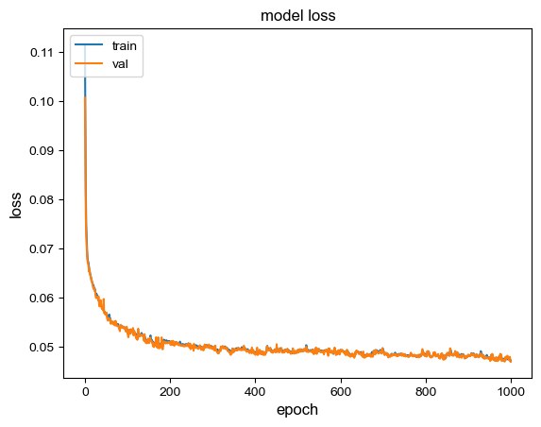
Classifier: CNN
Dataset - 21 Features Extra-Tree Classifier Dataset
Epochs – 1000
Iteration - 3
Loss | 0.047158
Accuracy | 0.838048
Val_Loss | 0.046935
Val_Accuracy | 0.839833

Slide 4
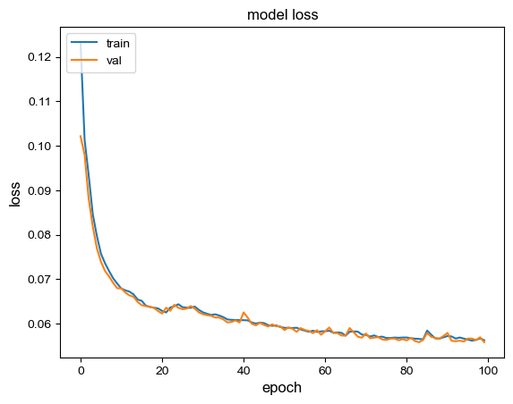
Classifier: CNN
Dataset - 21 Features Extra-Tree Classifier Dataset
Epochs – 100
Iteration -2
Loss | 0.05626
Accuracy | 0.806675
Val_Loss | 0.055816
Val_Accuracy | 0.808655

Slide 5
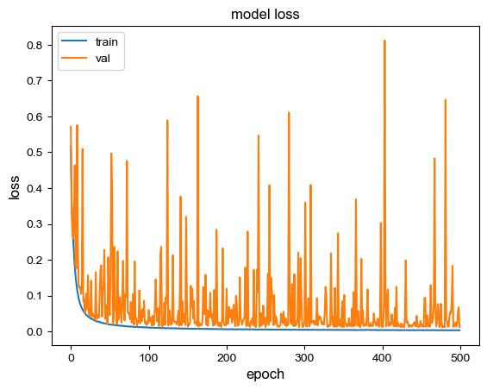
Classifier: RESNET
Dataset - 21 Features Extra-Tree Classifier Dataset
Epochs – 500
Learning Rate – 0.001
Iteration - 8
Loss | 0.003291
Accuracy | 0.998822
Val_Loss | 0.012631
Val_Accuracy | 0.998011

Slide 6
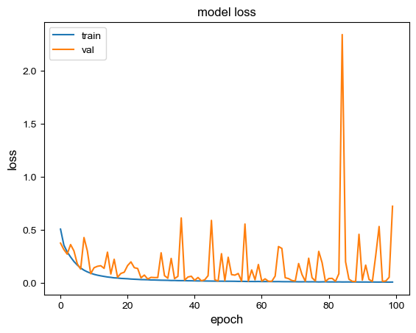
Classifier: RESNET
Dataset - 21 Features Extra-Tree Classifier Dataset
Epochs – 100
Learning Rate – 0.001
Iteration - 8
Loss | 0.010196
Accuracy | 0.996597
Val_Loss | 0.724427
Val_Accuracy | 0.877707

Slide 7
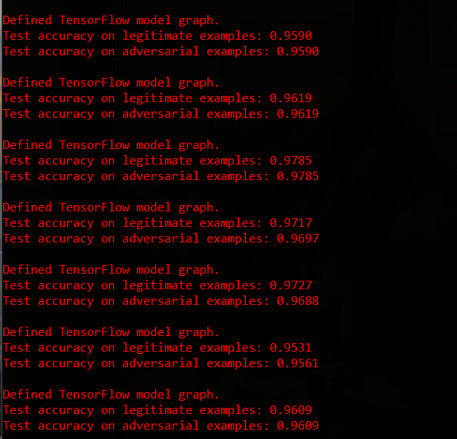
Adversarial Network

